Slide 1
Path to Production Data: SeaQuest Spectrometer
EMG Meeting
Paul E Reimer
13 December 2013

Slide 2
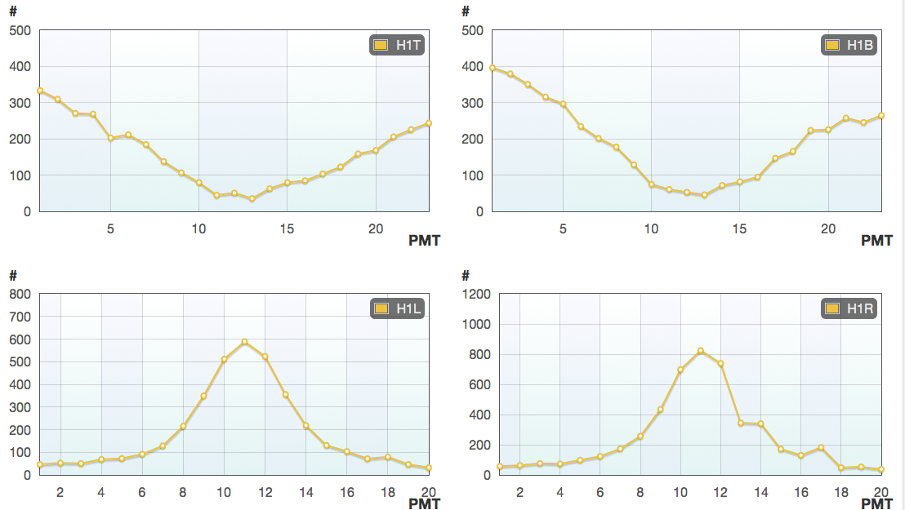
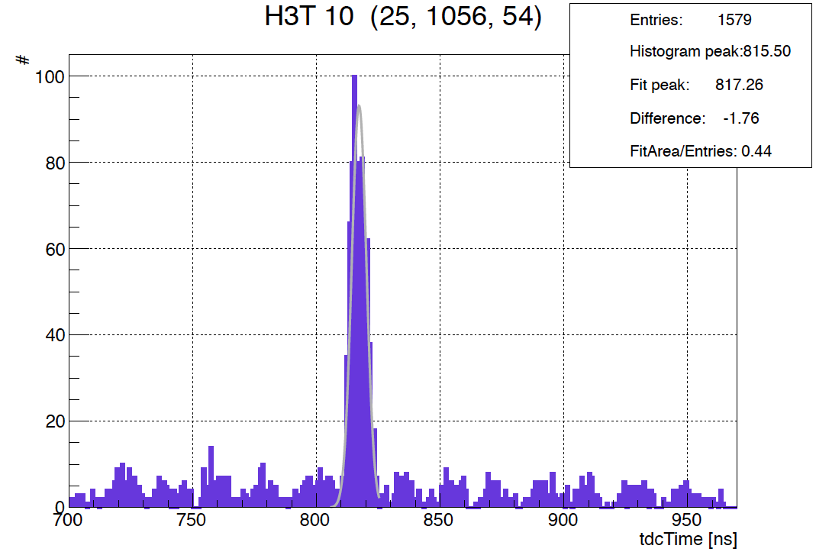
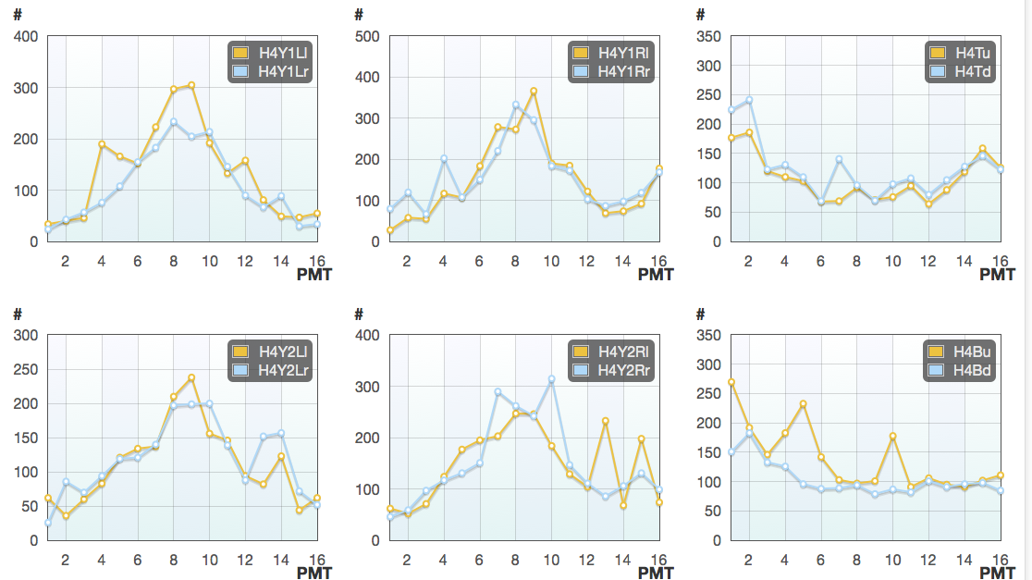
Commissioning—Hodoscopes
Verify
Channel Mapping ✔
Gain Match ✔
Test New Base Design--Illinois ✔
Does not appear to sag at high rate
Better gain (removed amplifiers)
Verify Timing ✔

Slide 3
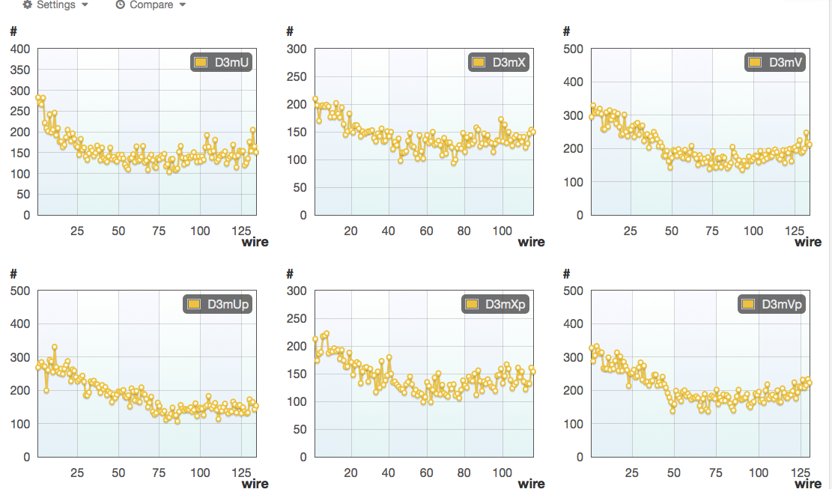
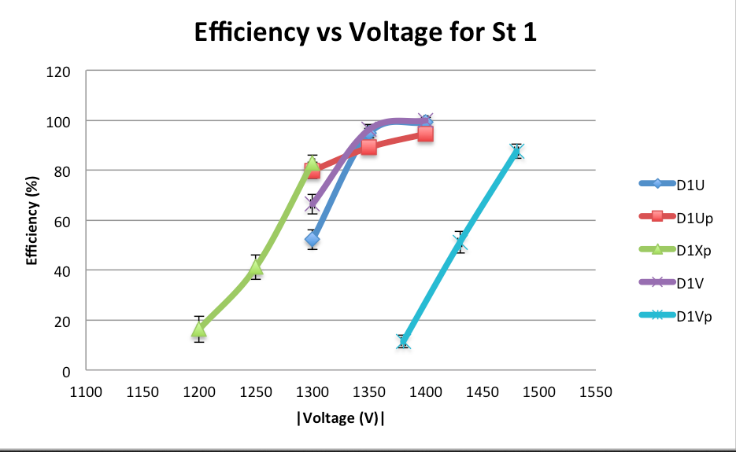
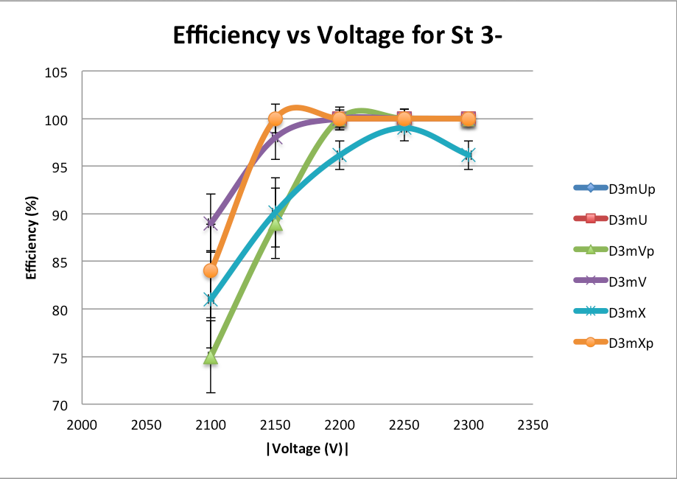
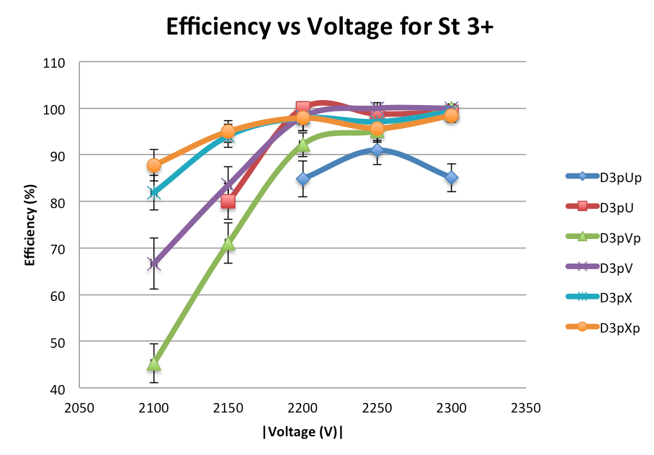
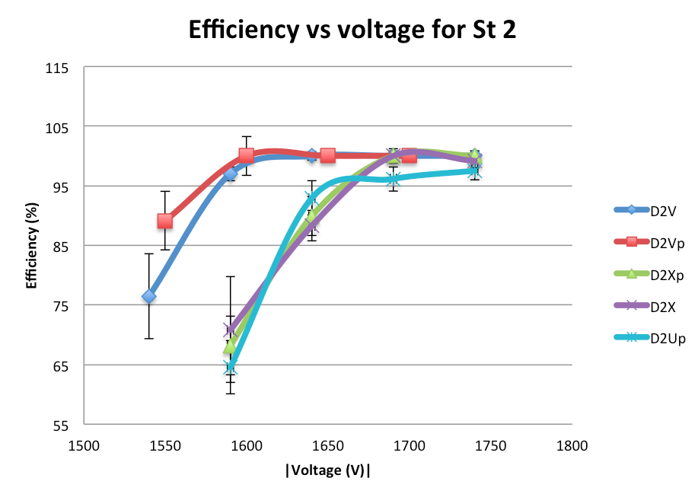
Commissioning—Tracking Chambers
Verify
Channel Mapping ✔
Plateau studies
In progress/finished early next week
R(t) curves

Slide 4
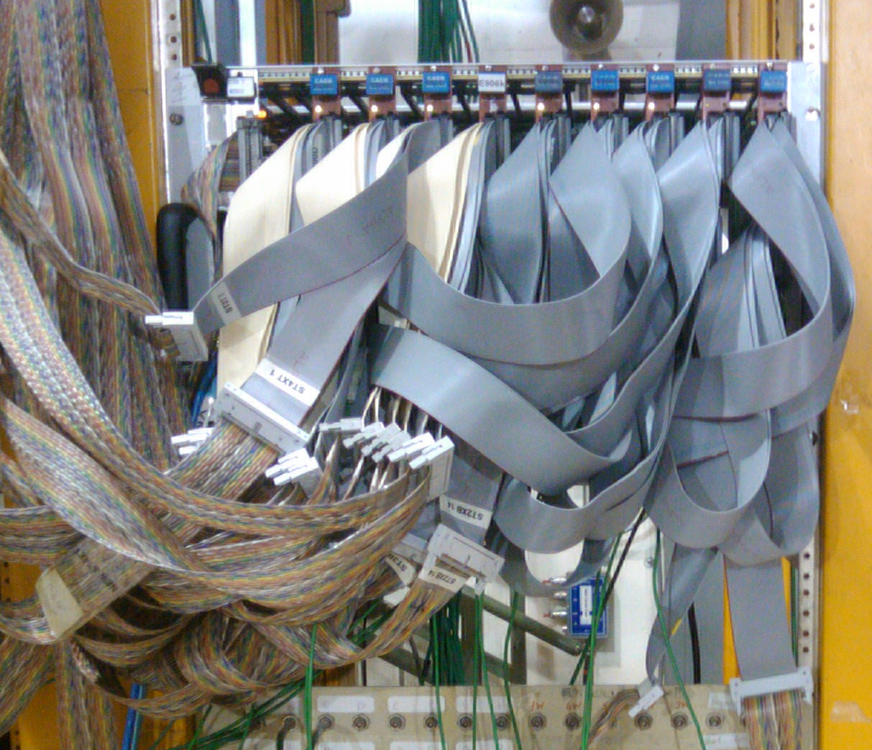
Present tasks
Trigger Commissioning
Do all triggered events contain roads on which we should trigger
Do “NIM” triggered events with roads contain an FPGA signal
Spectrometer Alignment with Tracking
Beam Cherenkov
Quantify Luminosity blocked and delivered
Full spill readout
Quantify how much needs to be blocked and still track events
The trigger is not a “black box”—its more like a Red box with grey cables all over

Slide 5
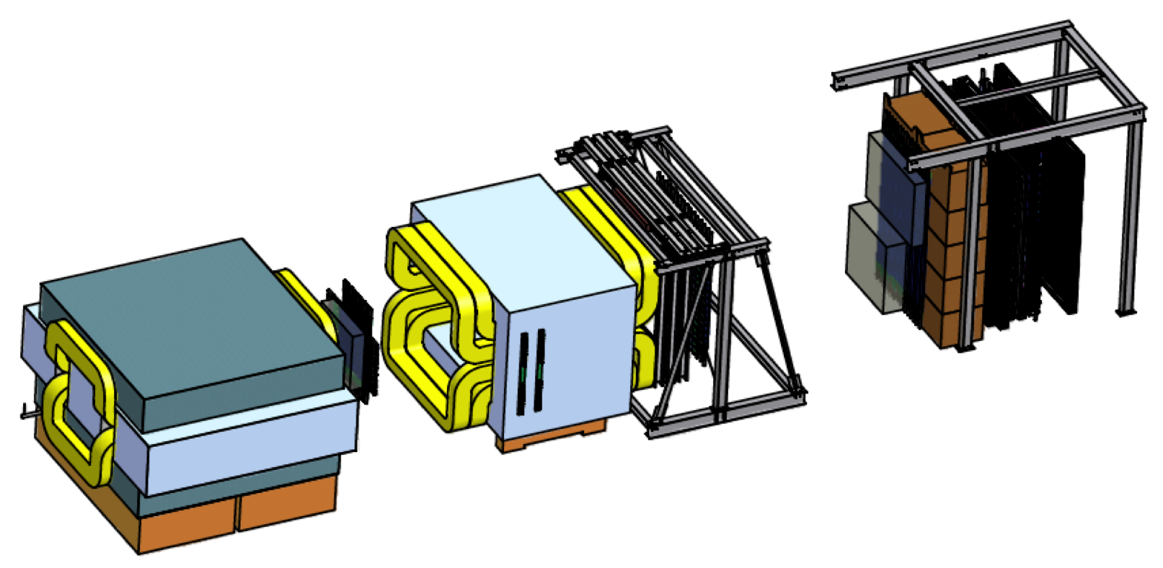
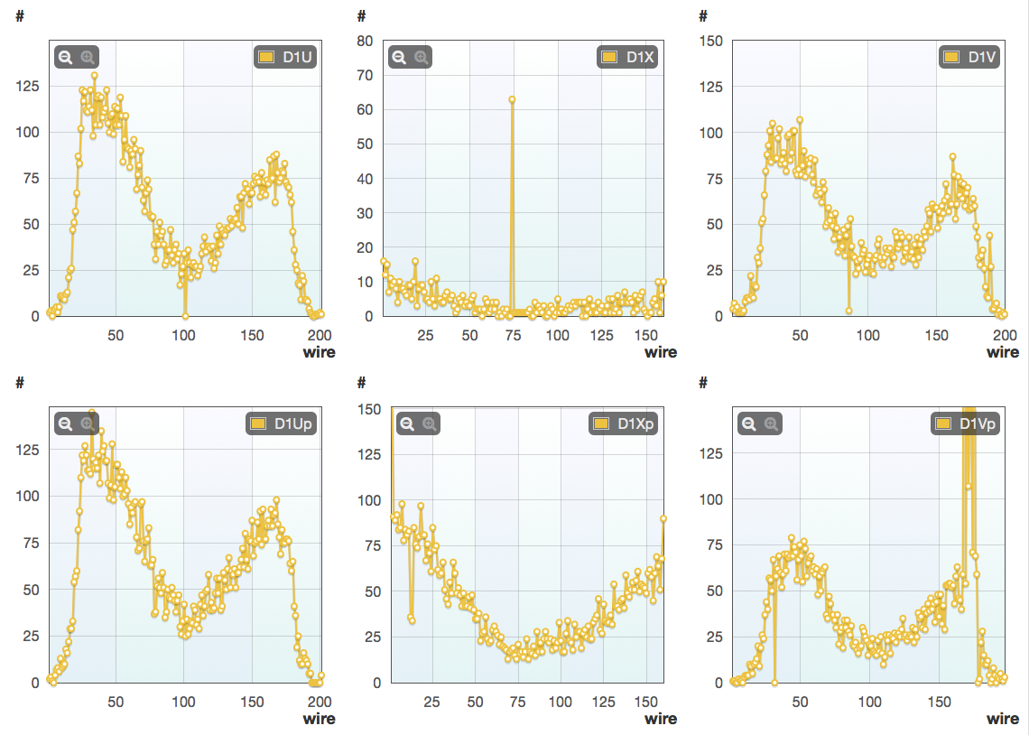
On Going Issues—St. 1
St. 1 X Tracking Chamber
Plane MIA
Will investigate on Tuesday/Wednesday Access

Slide 6
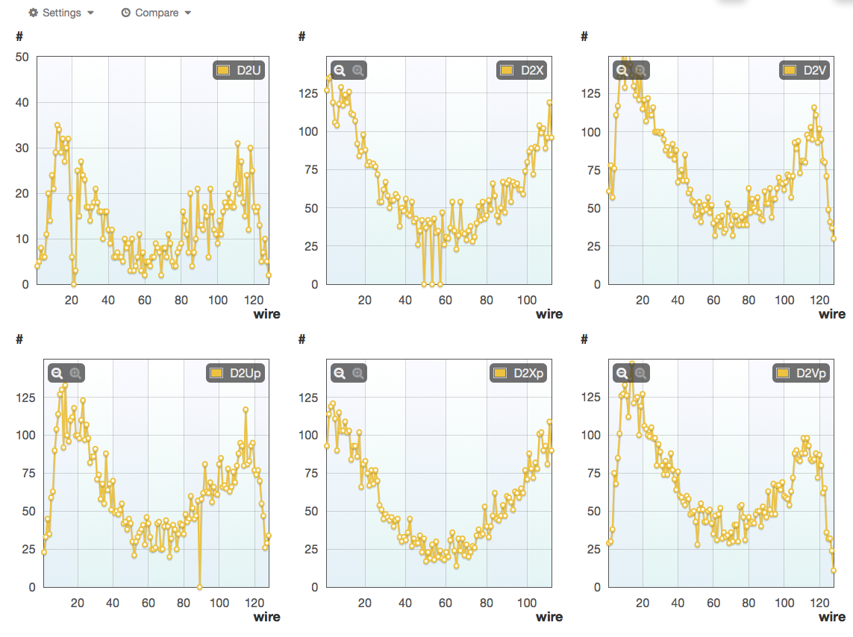
On Going Issues—St. 2
St. 2U Tracking Chamber
Large current draw.
Operating at reduced voltage.
Approx. 25% efficiency
Believe this is a broken wire.
Will investigate on Tuesday/Wednesday Access

Slide 7
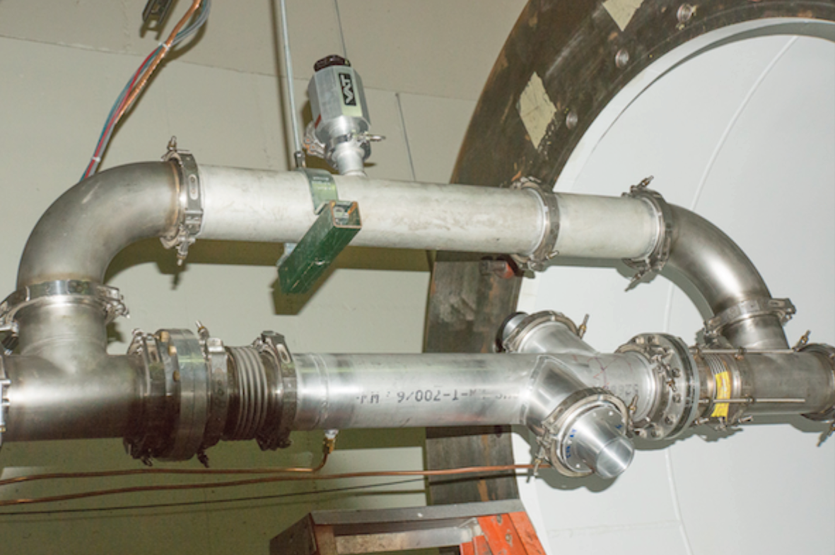
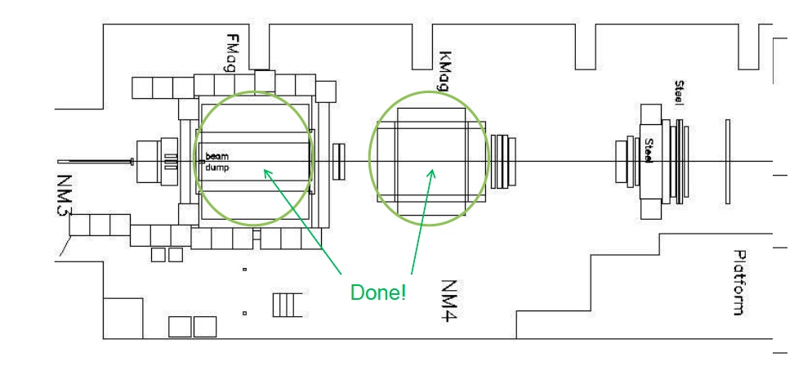
On Going Issues—Hall Radiation
Radiation levels appear to be higher than scaling from commissioning run
Possibly from newly installed beam Cherenkov
Solutions:
Move Cherenkov to NM2
Move Cherenkov nearer to target cave
Additional shielding
Beam
Mylar Mirror
Vacuum
Windows
Cherenkov

Slide 8
Other Items
New St. 1 Chamber
Ongoing work at Colorado
Wire stringing should be completed before Holiday break
Gas enclosure completed in early February
Assembly, testing and replacement of some wires in Lab 6 late February
Grid Computing
Started to use grid for MC and plan to move analysis there
Very light load
Sewer
FESS may need to dig near/under our beam line to resolve an issue with the sewer line from IARC and Feynman.
Presently this is thought to be a week of downtime, but not yet scheduled

Slide 9
Commissioning Summary
Targets ready and waiting
Magnets ready and waiting
Hodoscopes ready and waiting
Tracking
2 planes need repair—Tuesday and Wednesday
most voltage plateau curves complete
22/24 planes ready and waiting
Prop. Tubes ready and waiting
Trigger testing in progress
(This weekend)
Beam Cherenkov/splat block code work
Open questions
Beam quality (Don’s Talk)
Sewer Repair?
Ready to go soon!

